Slide 1
System Development Methods CT00046-3-2
Agile Methodologies

Slide 2
Topic & Structure of the Lesson
Understanding Agile Methodologies
Agile Principles

Slide 3
Learning Outcomes
By the end of this lecture, you should be able to :
Identify and explain the underlying principles of Agile methodologies.
List popular methodologies adopting Agile Principles.
Describe the advantages and disadvantages of Agile Methodologies.

Slide 4
Key Terms you must be able to use
If you have mastered this topic, you should be able to use the following terms correctly in your assignments and exams:
Agile Methodologies
Agile Principles

Slide 5
Principles of Agile Methodologies.

Slide 6

Modern Information System (IS) Methodologies
Developed in the mid 80’s to 90’s
Focus on fast delivery of software and customer satisfaction.
Compare with the Traditional Methodologies focus on product excellence and documentation.
Flexible stages
Most Methodologies adopt Agile Principles.
Example of modern methodologies:
RAD
XP
Scrum

Slide 7
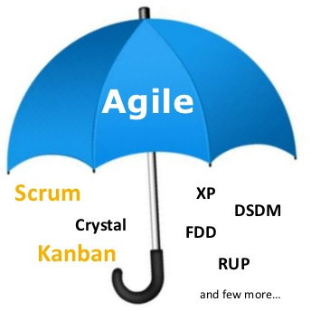
Agile Methodologies
Agile Methodologies are a set of Modern IS Methodologies which shares some of the Agile Principles.
Agile Principles are defined in ‘The Agile Manifesto’, developed by software developers in 2001 (https://agilemanifesto.org/):
Value responding to change over following a plan.
Value individuals and interactions over processes and tools.
Value working software over comprehensive documentation.
Value customer collaboration over contract
negotiation.
Agility (in a software development sense) means:
Being flexible.
Being in control.
Able to adapt to changing environment.

Slide 8
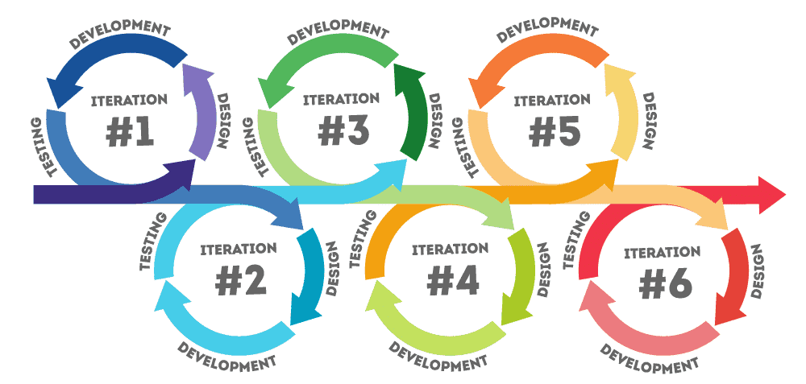
Agile Methodologies (Cont.)
Stresses intense team-based effort.
Some Agile methodologies adopt both iterative and incremental approaches which means:
Breaks development process down into cycles or iterations that add functionality. Each iteration is designed, build, and tested in an ongoing process. Attempts to reduce major risks by incremental steps in short time intervals.
Also, agile methodologies attempt to develop a system incrementally, by building a series of prototypes and constantly adjusting them to user requirements. As the agile process continues, developers revise, extend, and merge earlier versions into
the final product.
An agile approach emphasizes continuous feedback, and each incremental step is affected by what was learned in the prior steps.

Slide 9
Watch the following video to know more about Agile:
https://www.youtube.com/watch?v=ZZ_vnqvW4DQ&ab_channel=MarkShead

Slide 10
The Agile Manifesto is based on twelve principles
1
10
11
9
3
2
6
8
7
4
5
12
Customer satisfaction by early and continuous delivery of valuable software
Welcome changing requirements, even in late development
Working software is delivered frequently (weeks rather than months)
Close, daily cooperation between business-people and developers
Projects are built around motivated individuals, who should be trusted
Face-to-face conversation is the best form of communication (co-location)
Working software is the principal measure of progress
Sustainable development, able to maintain a constant pace
Continuous attention to technical excellence and good design
Simplicity - the art of maximizing the amount of work not done—is essential
Best architectures, requirements, and designs emerge from self-organizing teams
Regularly, the team reflects on how to become more effective, and adjusts accordingly

Slide 11
Agile Principles
Customer satisfaction by early and continuous delivery of valuable software
The analysis by MIT Sloan Management Review (Alan, 2001) found several practices that contribute to the final system quality. This includes ‘the less functional the initial delivery, the higher the quality in the final delivery’. Besides, ‘the more frequent the deliveries, the higher the final quality’.
Agile practice strives to deliver a rudimentary system within the first few week of the start of the project. Then, continue to deliver systems of increasing functionality every two weeks.
Users may choose to put these system into production if it is functional enough, or to review existing one and report on changes they want made.

Slide 12
Agile Principles (Continue)
Welcome changing requirements, even in late development
Agile participants are not afraid of change. They view changes to the requirements as good things, as the team take this as learning phase to understand more about what it will take to satisfy the market.
Team keeps the structure of its software flexible so that when requirements change, the impact to the system is minimal.
Working software is delivered frequently (weeks rather than months)
Working software will be delivered early (after the first few weeks) and often (every few weeks thereafter), instead of delivering bundles of documents or plans. The main goal is to delivery product that satisfies the user’s needs.

Slide 13
Agile Principles (Continue)
Close, daily cooperation between business-people and developers
Significant and frequent interaction between business users, developers, and stakeholders is required. A software project must be continuously guided.
Projects are built around motivated individuals, who should be trusted
Provide required environment and support what project team members need and trust them to get the job done.
In an agile project, people are the most crucial factor of success, besides other factors i.e., process, environment, management, etc. – which are subject to change if they are having an adverse effect upon the people. For example, if the office environment or the process steps are obstacles to the team, then these must be changed.

Slide 14
Agile Principles (Continue)
Face-to-face conversation is the best form of communication (co-location)
Face-to-face conversation is the primary mode of communication.
An agile project team does not demand written specifications, plans, or designs. Team members may create them if they perceive an immediate and significant need, but they are not the default. The default is conversation.
Working software is the principal measure of progress
Agile projects measure their progress by measuring the amount of software that is meeting the user’s need.
They don’t measure their progress in terms of phase that they are in or by the quantity of documentation that has been produced.
They are 30% done when 30% of the main functionality is working.

Slide 15
Agile Principles (Continue)
Sustainable development, able to maintain a constant pace
An agile project team does not take off at full speed and try to maintain that speed for duration. Rather, they run at a fast, but sustainable, pace.
Team works at a rate that allows them to maintain the highest quality standards for the duration of the project.
Continuous attention to technical excellence and good design
High quality is the key to high speed. The way to go fast is to keep the software as clean and robust as possible. Thus, all agile team members are committed to producing only the highest quality code they can.
Simplicity—the art of maximizing the amount of work not done—is essential
An agile project team take the simplest path that is consistent with their goals, they focus on the desired outcome.
The simplest and highest-quality work will be done, and that it will be easy to change when problems arise.

Slide 16
Agile Principles (Continue)
Best architectures, requirements, and designs emerge from self-organizing teams
An agile team is a self-organizing team. Responsibilities are not handed to individual team members, it is communicated to the team, and the team determines the best way to fulfill them.
Agile team members work together on all aspects of the project. The team shares responsibilities, and each team member has influence over them.
Regularly, the team reflects on how to become more effective, and adjusts accordingly
An agile team continually adjusts its organization, rules, conventions, relationships, etc. They know that its environment is continuously changing, and they must change with that environment to remain agile.

Slide 17




Agile Principles (summarized version)
Agile Principles (summarized version)
Customer Satisfaction
By fast and frequent delivery of products.
Welcome changing requirements, even late in development.
Teamwork
By Face-to-face communication with all people involved.
Motivate and trust developers.
Fast Development
Break bigger system into small and manageable components.
Close monitoring of development.
High Product Quality
Maintain good design and simplicity.
Adopt to latest technologies.

Slide 18
Popular Methodologies Adopting Agile Principles

Slide 19
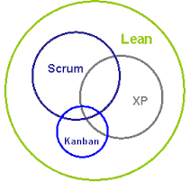
Popular IS Methodologies Adopting Agile Principles
Extreme Programming (XP).
For advance / heavy coding projects
SCRUM
A ‘team-work’ based methodology
Rapid Application Development (RAD)
Used for small and fast projects
Dynamic Systems Development Method (DSDM).
Improvement on RAD, focus on rapid prototyping
based on users’ feedback.
Feature Driven Development (FDD).
For long-term projects that frequently
change and add features in regular,
predictable iterations
Agile

Slide 20
Popular IS Methodologies Adopting Agile Principles (Cont.)
Lean software development.
Focuses on identifying and eliminating waste, while improving the software quality continuously.
Dialogue-Driven Development (aka d3).
Put users’ interaction and communication as the highest priority in a successful project.
Kanban Methods
Allows you to get a whole picture of a project by visualizing the workload and the development progress.
For warehousing
Buddhism methodologies
Most of the above Methodologies share most (or all) of the Agile Principles.
Agile

Slide 21
Advantages and Disadvantages

Slide 22
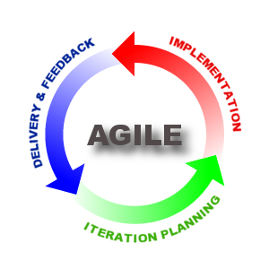
Advantages of Agile Methodologies
Customer satisfaction with frequent delivery of the working product.
Gives customers/users ‘power’ to change their minds anytime and send new requirements.
Gives more ‘control’ to core developers to make decisions
Emphasize the use of the latest design and technologies
Encourage close communication and teamwork.

Slide 23
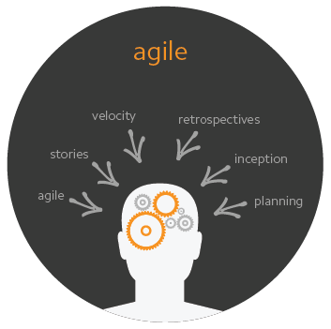
Disadvantages of Agile Methodologies
Users/customers not available at all times.
Developer - difficult to determine final cost and development time as requirements keep changing
Developer – difficult to plan and deliver workable products frequently.
Experts' developers and CASE Tools are expensive
Often lack comprehensive documentation

Slide 24
Summary
The Agile Methodologies are a set of Modern IS Methodologies that shares some of the Agile Principles.
Agility in a software development sense means being flexible, being in control, and being able to adapt to changing environments.
The Agile principles focus on customer satisfaction, fast development, teamwork, and high product quality.
Popular methodologies that share some Agile principles include XP, RAD, FDD, DSDM, Lean, D3, and Kanban.
In Agile methodologies, developers might face difficulties to determine the final cost, development time, and delivering workable products frequently as requirements keep changing.

Slide 25
Question & Answer

Slide 26
Next Session
Process Oriented Methodologies

Slide 27
References
Satzinger, J. W., Jackson, R. B., & Burd, S. D. (2015). Systems Analysis and Design in A Changing World. Cengage learning.
Martin, R. C., Newkirk, J., & Koss, R. S. (2003). Agile Software Development: Principles, Patterns, and Practices (Vol. 2). Upper Saddle River, NJ: Prentice Hall.
Alan, M. (2001). Product-development practices that work: How Internet companies build software. MIT Sloan Management Review, 40(2).

